Slide 1
New Directions for Transformative Learning: Can it be a Critical Pedagogy for World Crises?
Ted Fleming
at
Teachers College
October 24, 2023
Email ejf2129@tc.columbia.edu

Slide 2
The strengths and weakness of transformative learning following 45 years of research and scholarship.
The opportunities for future progress through research, teaching and scholarship.
The challenges from powerful social, institutional and policy imperatives that prioritize instrumental and functional thinking.
The emerging threats from global rise of far-right movements and other forms of uncritical thinking.
Can transformative learning help address various crises that face the world, especially climate change?

Slide 3
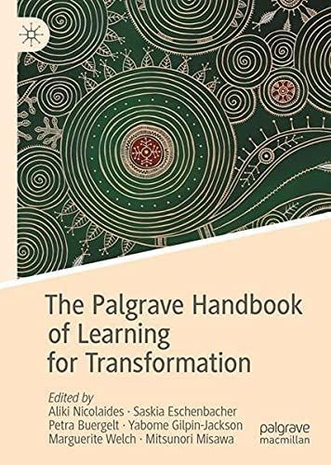
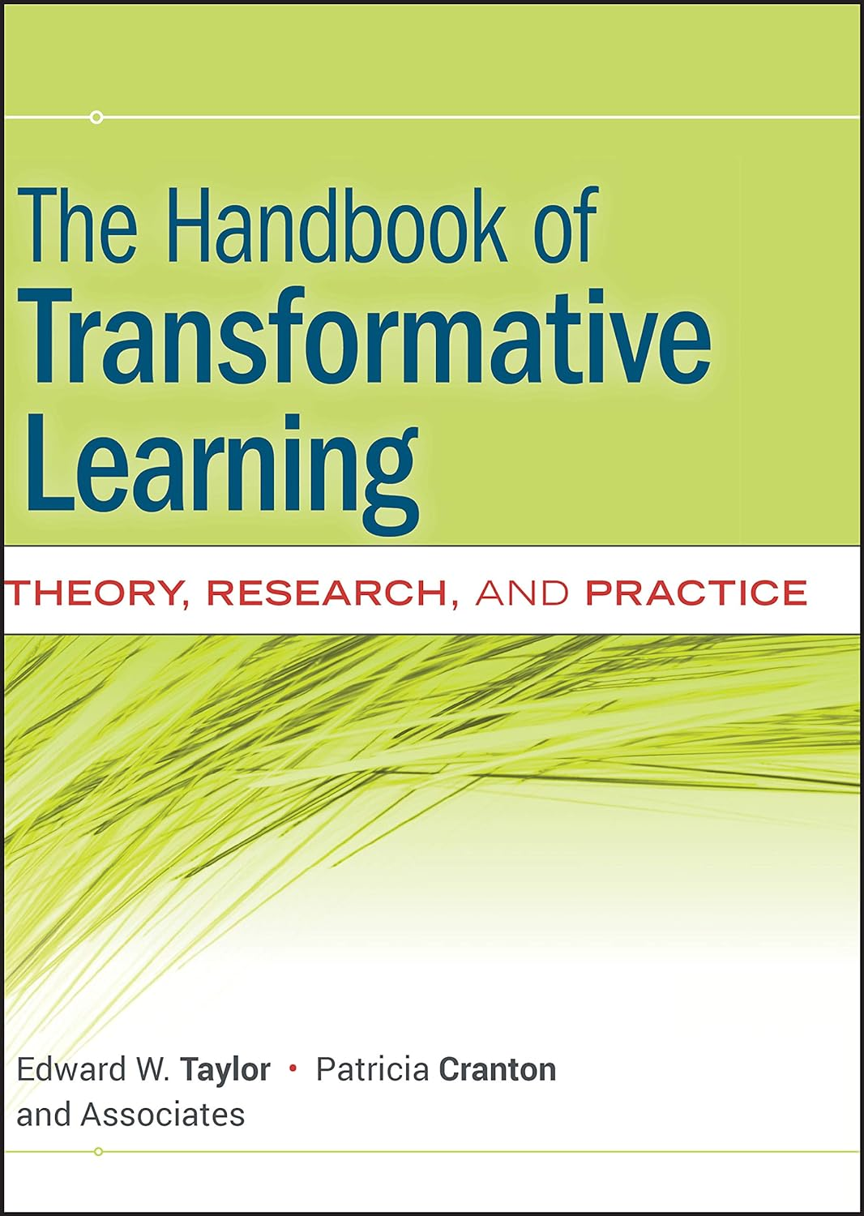
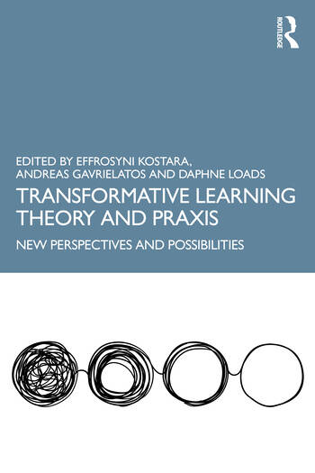
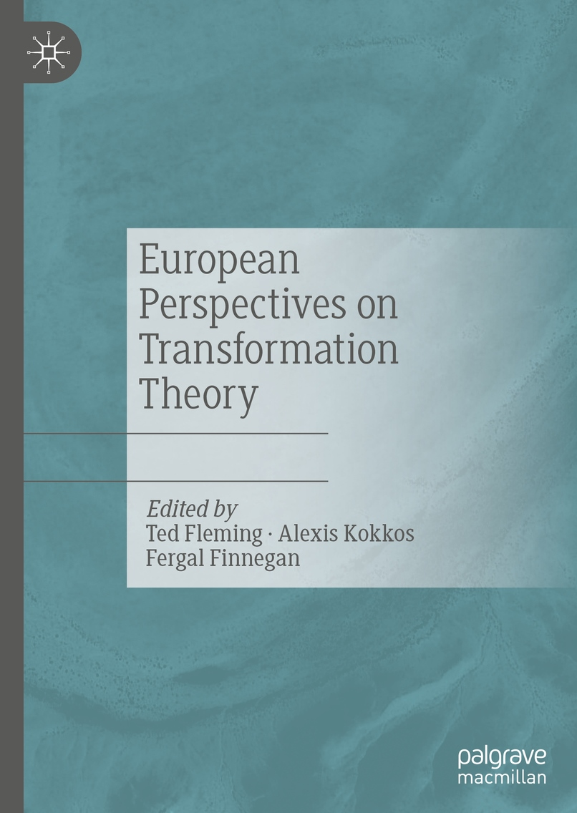
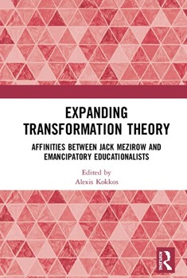
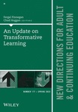
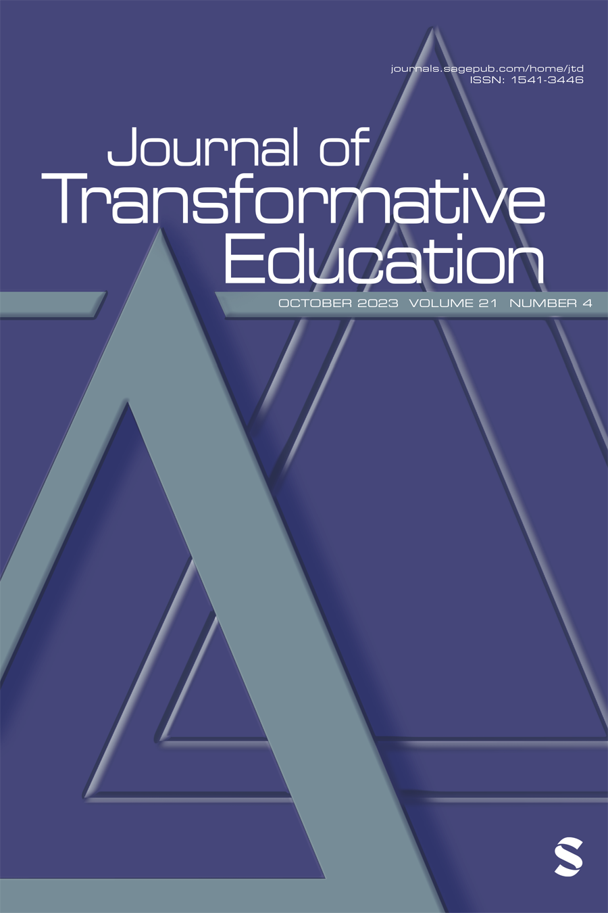
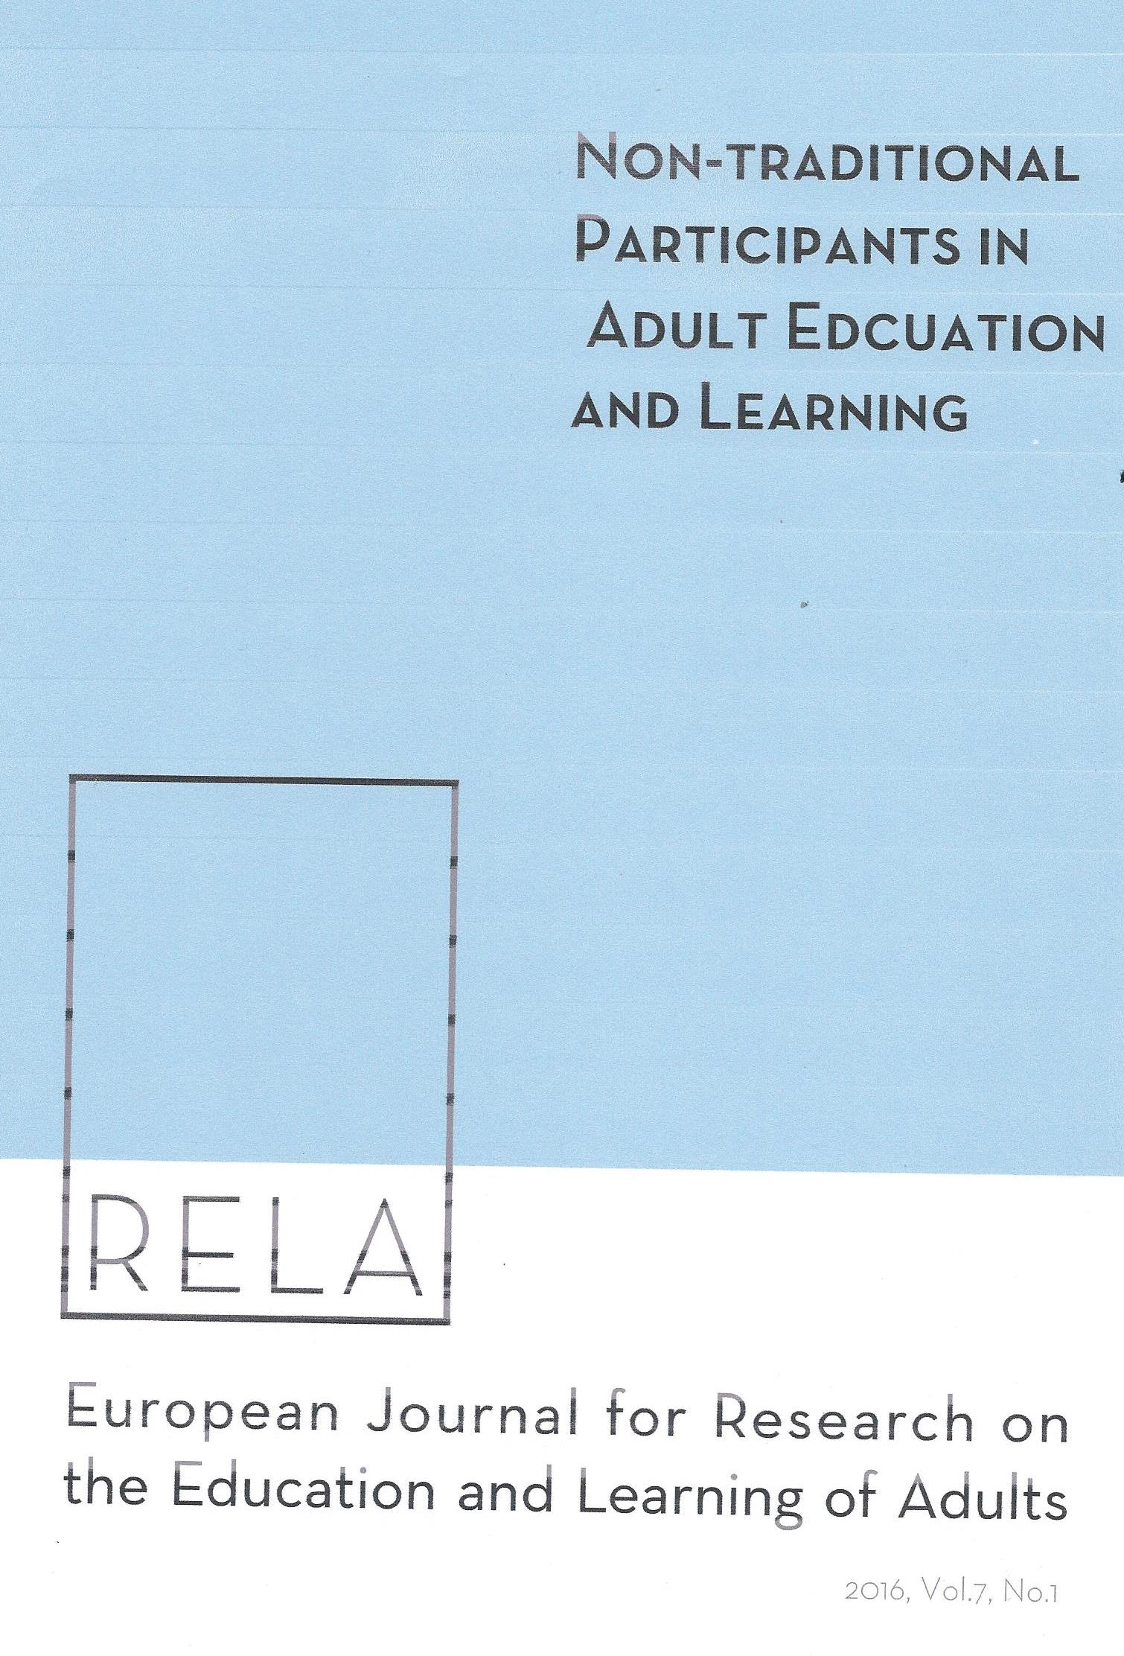

Slide 4
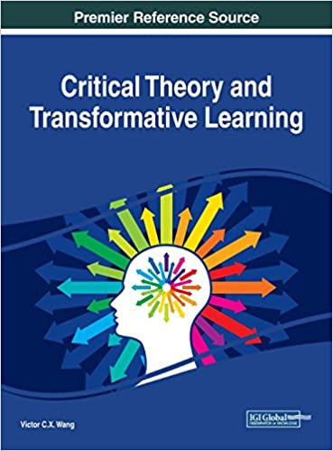
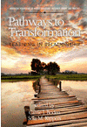
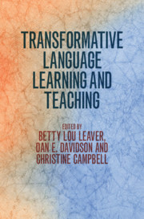

Slide 5
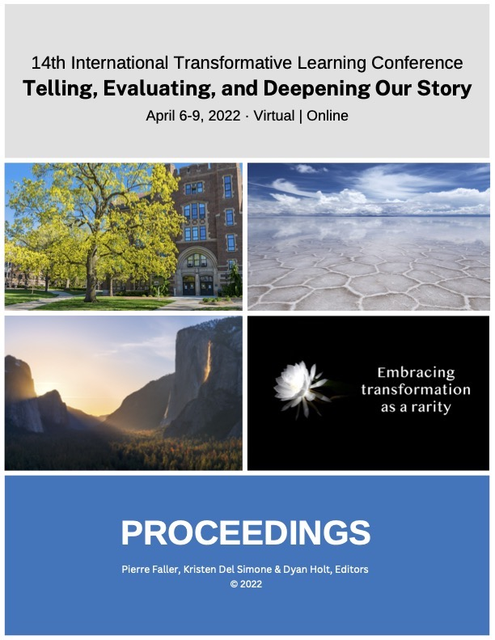
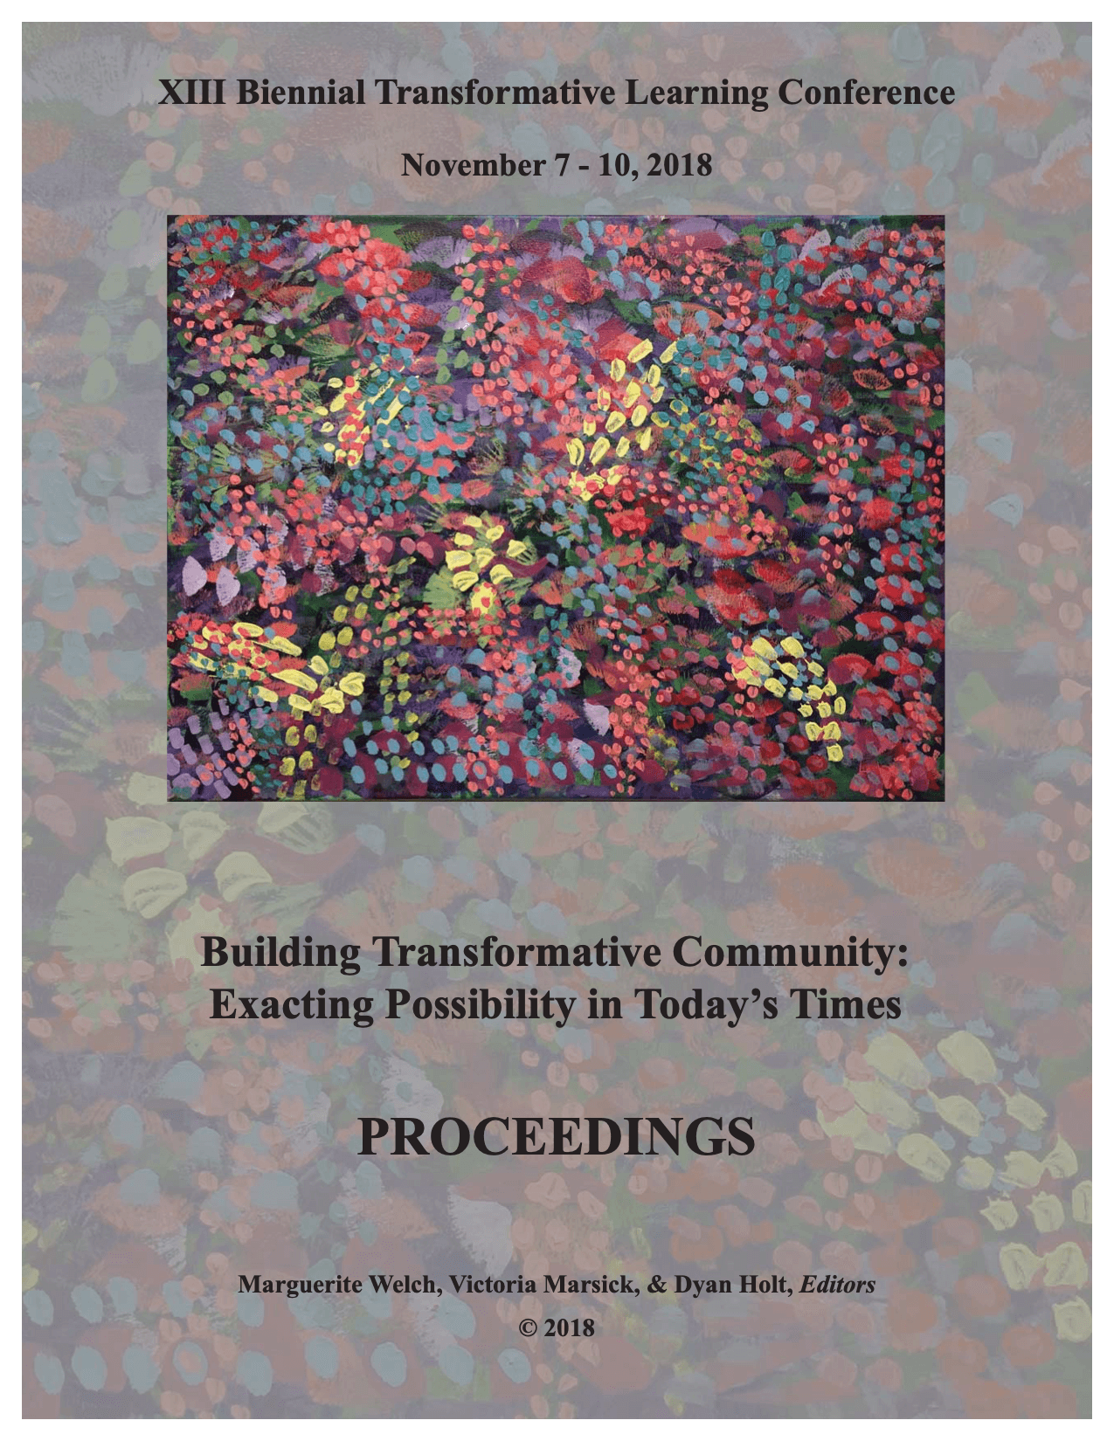
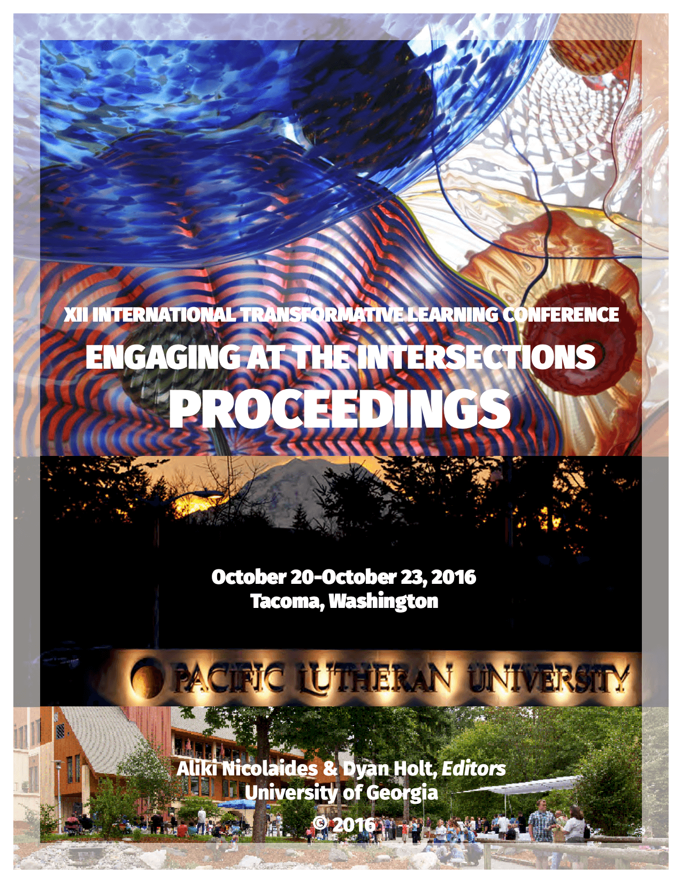
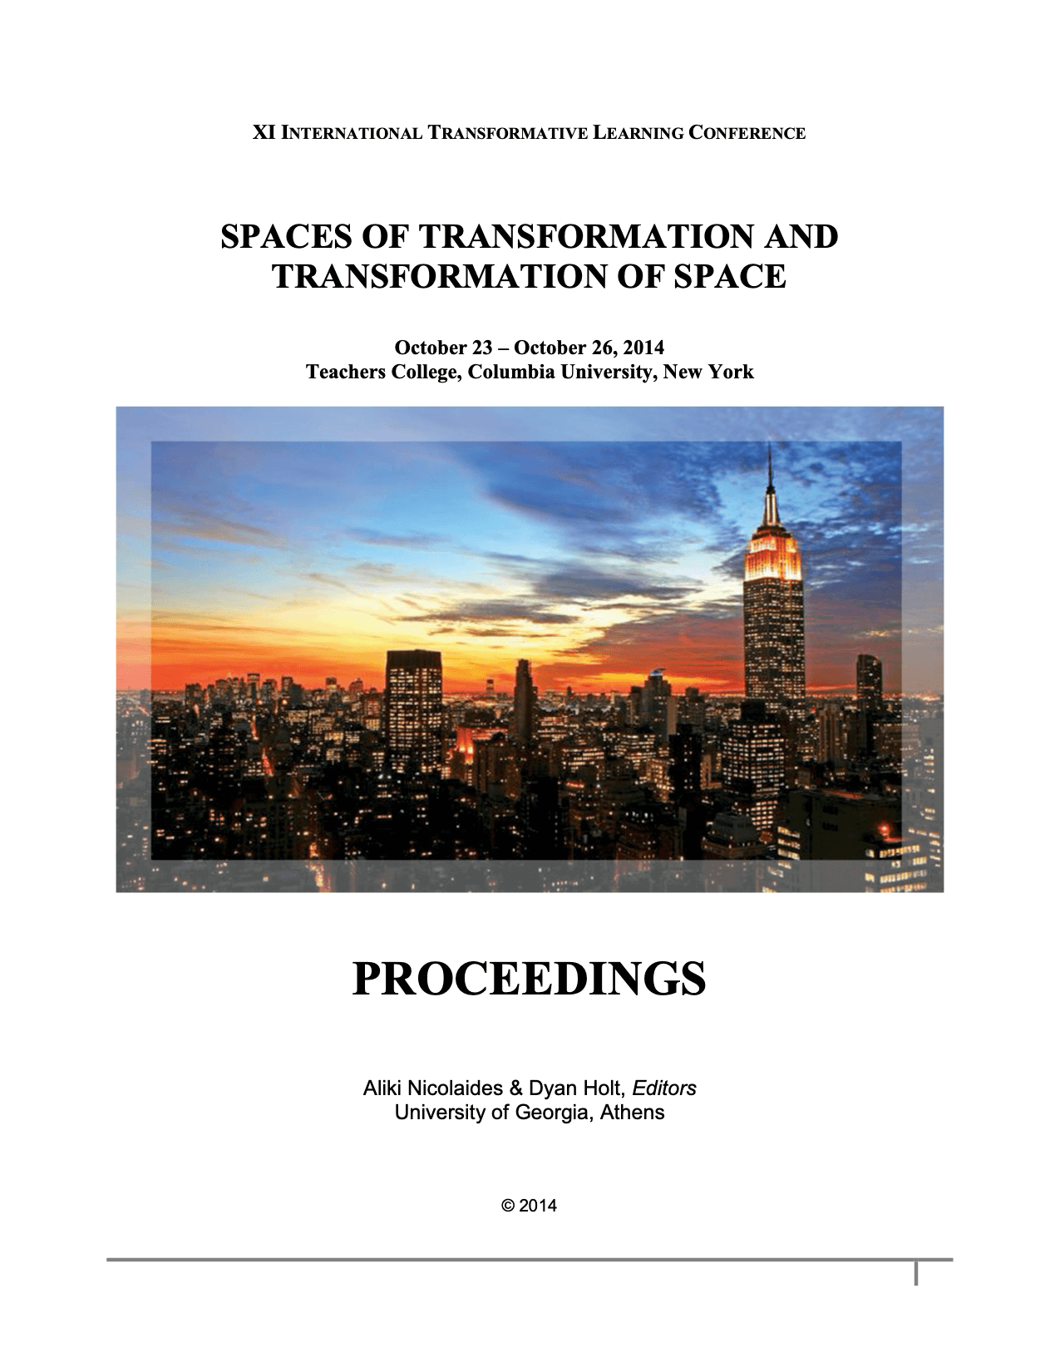
ITLAssociation Conferences
1998- 2022 & 2024
https://itlc2024.intertla.org/

Slide 6
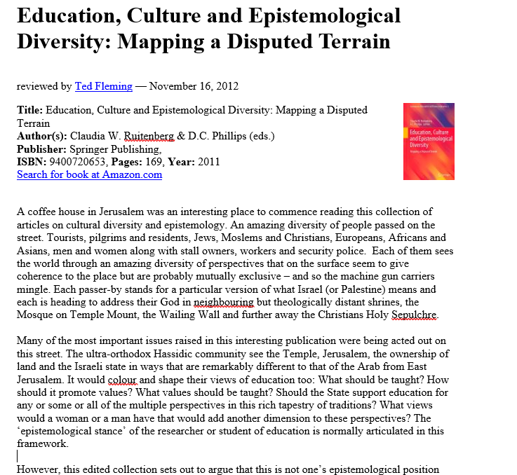

Slide 7
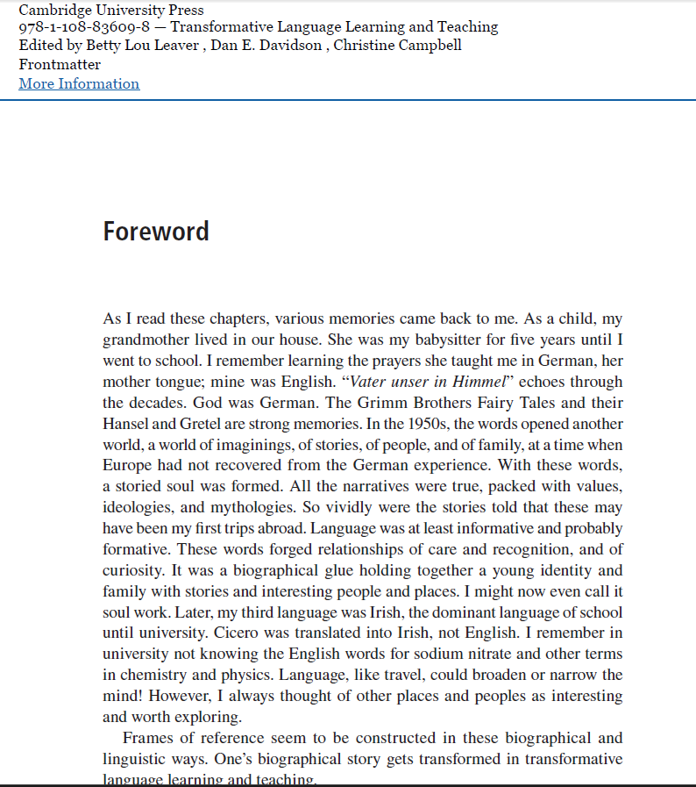

Slide 8
What is TL? Slide 1
Transformative learning is according to Mezirow (1985, p. 22) the;
…the process of becoming critically aware of how and why the structure of
our psychocultural assumptions has come to constrain the way in which we
perceive our world, of reconstituting that structure in a way that allows us to
be more inclusive and discriminating in our integrating of experience and to
act on these new understandings...
For Mezirow (2000: 7–8) transformative learning is:
the process by which we transform our taken-for-granted frames of reference
(meaning perspectives, habits of mind, mind-sets) to make them more
inclusive, discriminating, open, emotionally capable of change, and reflective
so that they may generate beliefs and opinions that will prove more true or
justified to guide action.

Slide 9
TL is a critical process of
becoming critically aware of how and why the structure of our psychocultural
assumptions has come to constrain the way in which we perceive our world, of
reconstituting that structure in a way that allows us to be more inclusive and
discriminating in our integrating of experience and to act on these new
understandings.

Slide 10
What is TL? Slide 2
the phases of transformation (Mezirow & Associates, 2000, p. 22) as:
A disorienting dilemma;
Self-examination with feelings of fear, anger, guilt or shame;
A critical assessment of assumptions;
Recognition that one’s discontent and the process of transformation are shared;
Exploration of options for new roles, relationships and actions;
Planning a course of action;
Acquiring knowledge and skills for implementing one’s plans;
Provisional trying new roles;
Building competence and self-confidence in new roles and relationships;
A reintegration into one’s life on the basis of conditions dictated by one’s new
perspectives.)
Mezirow, J., & Associates. (Eds.). (2000). Learning as transformation: Critical perspectives on a theory in progress. Jossey-Bass.

Slide 11
Strengths and Weaknesses
TL is an theory of learning by adults; for adults and adult educators. It is indigenous
Empirical confirmations;
Has a ring of truth when adults examine it;
Prompted a number of ‘spin-offs’ all related to the concept of transformation; Yorks and Kasl working on Heron’s theory of personhood;
Larry Green on agency and disorienting dilemmas, etc.
Karpen on multiple selves and transforming the self;
Alhadeff-Jones on temporalities of TL;
Boyd and Myres on Jung and TL;
Illeris a comprehensive map of adult learning;
Kegan on differentiation of subject/object;
Dirkx on soul and TL
O’Sullivan on ecological issues and TL.
Interdisciplinary – developmental psychology, construct theory, social psychology, critical theory.
Journals, conferences, organizations ITLA; ESREA, etc.

Slide 12
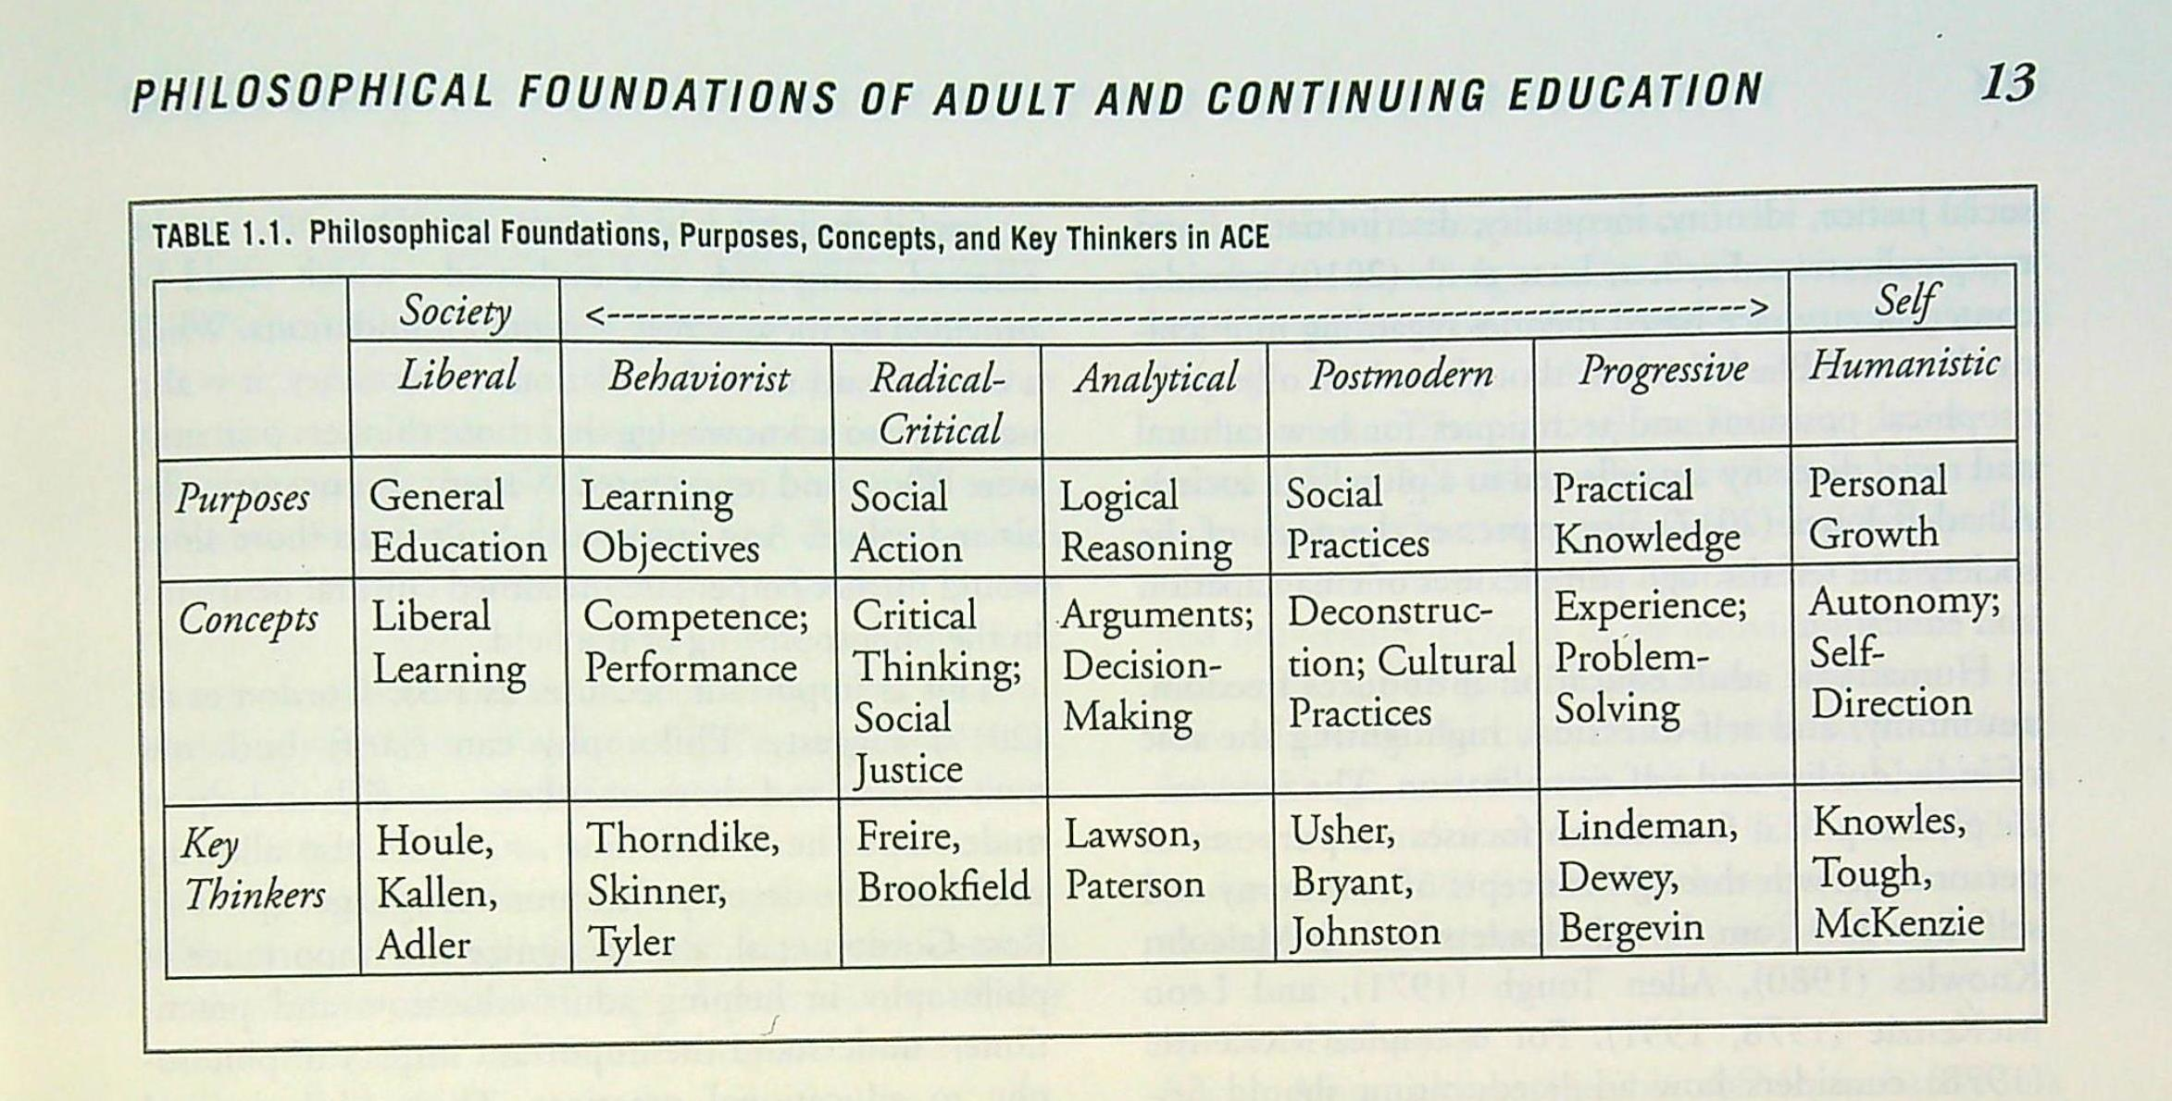
Weaknesses and Strengths
The role of TL in the field of adult education?
A certain ‘stuckness’ (Finnegan, 2023a, p. 120)….
But Kuhn’s paradigm theory predicts exactly that and the stuckness is appropriate according to the model of Kuhn’s paradigm change!.

Slide 13
Weaknesses
Good theoretical and empirical work done in areas of emotions, spirituality, feminist literature and practices, organizational change etc. (see ITLC);
Not so much work done in these areas:
Teaching methods for TL;
Social Justice orientations;
Emancipatory social change.
Even less done on:
Critical theory and critical sociology;
political philosophy, political economy, social class, disability.
(See Hoggan & Finnegan, 2023)

Slide 14
This is the Age of Experience
Dewey: Education is the reconstruction of experience;
Hannah Arendt (2018) held that rigorous thinking should be grounded in lived experience – in her case it was her experience of being a Jew in Europe, arriving in New York as a stateless person:
No matter how abstract our theories may sound or how consistent our
arguments may appear, there are incidents and stories behind them which
at least for ourselves, contain in a nutshell the full meaning of whatever we
have to say. Thought itself…arises out of the actuality of incidents, and
incidents of lived experience must remain its guideposts by which thinking
soars, or into the depths to which it descends. (p. 200)
Arendt, H. (2018). Thinking without a banister: Essays in understanding 1953-1975. Schocken

Slide 15
Critical Theory and TL – Allies for the Future
Jürgen Habermas – Mezirow relied on Habermas for
kinds of learning – instrumental, interpersonal, emancipatory;
communicative action = the kinds of conversations that are
emancipatory, democratic, will formation, transformative.
Unfortunately, for many this is too rational, cognitive…pathology is
miscommunication
Axel Honneth – a recognition turn in critical theory:
recognition in childhood and family Bowlby
in adulthood in society/ state through laws Laws
and in the realm of work/community. Work
Recognition is very often experienced by returning to learning and
that experience is both deeply personal and political.
Social pathology is misrecognition.
Oskar Negt (and his film-making friend Alexander Kluge)
“Experiences of the world unite!”

Slide 16
Useful concepts from Negt & Kluge
Experience as dialectical;
Experience of Neoliberal Capitalism;
From Reconstructing Experience (Dewey) to Transforming Experience (TL) to Transforming Experience Dialectically (Negt & Kluge);
Sociological imagination (Alfred Schutz, C. Wright Mills….Negt & Kluge)
History and Obstinacy: Psychological Imagination and Sociological Imagination )
[where and history and society meet the personal in Negt and Kluge]

Slide 17
Oskar Negt & Alexander Kluge: Concepts for the future
The Age of Experience and why is it so important?
The public sphere, democracy and critical social change
Experience as Dialectical
The Sociological Imagination….beyond the dominance of the psychological
imagination?
C.Wright Mills, Alfred Schutz
The next big idea Negt…..beyond Freire and into European
Critical Theory (again)!

Slide 18
Modern Times – Charlie Chaplin via Fleming to Negt
https://www.bing.com/videos/riverview/relatedvideo?q=charlie+chaplin+modern+times+factory+scene&mid=BD1B6CE674D4FEF7DC0ABD1B6CE674D4FEF7DC0A&FORM=VIRE

Slide 19
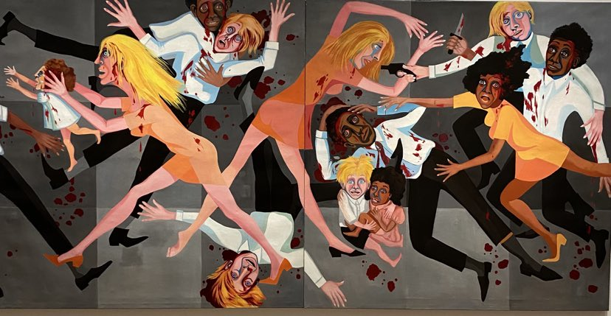
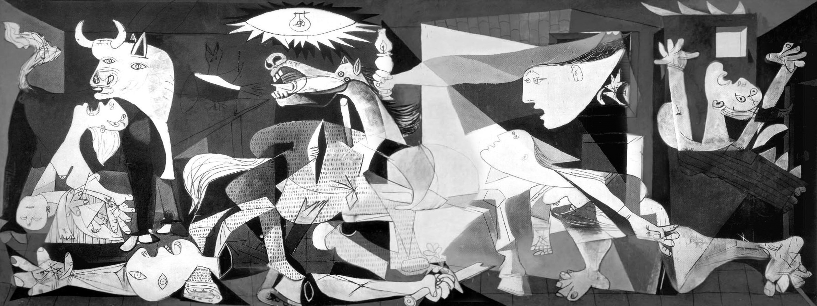

Slide 20
Alfred Schutz (1967):
“By the term ‘wide-awakeness’ we want to denote a plane of consciousness of highest tension originating in an attitude of full attention to life and its requirements. Only the performing and especially the working self is fully interested in life and, hence, wide-awake…. This attention is an active, not a passive one. Passive attention is the opposite to full awareness.” (p. 213)
Picasso (in Malraux, 1974)
“You have to wake people up. To revolutionise their way of identifying things. You’ve
got to create images they won’t accept…Force them to understand that they’re living
in a pretty queer world. A world that is not reassuring. A world that’s not what they think it is.”

Slide 21
Conclusion
This requires, I think, an integrated theory of critical reflection on experience, and a democracy that seeks to tackle inequality, exclusions, and misrecognition, being mindful of the dynamics of capitalism and alert to the extraordinary nature of human capacities.
I suggest that Dewey (1937), Freire, Mezirow, Negt, and Kluge offer useful way points for such a theory – a theory that will introduce and induce perplexity, curiosity, thinking, critical reflection and lead students to wide-awakeness, to imagine and become active agents of personal and social transformation….

Slide 22
Publications in 2023
Fleming, T. (in press, 2023). Experience and sociological imagination: Transforming the researcher’s learner identity. European Journal for Research on the Education and Learning of Adults (RELA),
http://www.tedfleming.net/doc/Transforming_Researcher_incl_author_name.pdf
Fleming, T. (2023). Transformative learning and experience: Fostering new learning links between the personal and political. International Journal of Adult Education and Technology, 14(1), 1-13.
http://www.tedfleming.net/doc/Transformative-Learning-and-Experience_-Forging-New-Learning-Links-Between-the-Personal-and-Political.pdf
Finnegan, F. (2023). A many-splendored thing? Transformative learning for social justice. New Directions for Adult and Continuing Education, 2023 (177). 119–133. https://doi.org/10.1002/ace.20483
Hoggan, C., & Finnegan, F. (2023). Transformative learning theory: Where we are after 45 years. New Directions for Adult and Continuing Education, 2023 (177), 5–11. https://doi.org/10.1002/ace.20474

