Slide 1
Adult Learning and Experiences of Crises: Interrogating Critical Theory, Democracy and Citizenship Education
Ted Fleming
Adjunct Associate Professor
Teachers College Columbia University, New York
at
National and Kapodistrian University of Athens, March 30, 2023
Conference
Lifelong Learning and Adult Education in Turbulent Times:
Paths to Social Inclusion and Social Cohesion”

Slide 2
Yiannis Ritsos - Schῆma tou pousia
Ὅ,τι ἔφυγε, ριζώνει ἐδῶ, στὴν ἴδια θέση, λυπημένο, ἀμίλητο
ὅπως ἕνα μεγάλο βάζο τοῦ σπιτιοῦ, ποὺ πουλήθηκε κάποτε
σὲ δύσκολες ὧρες,
καὶ στὴ γωνιὰ τῆς κάμαρας, ἐκεῖ ποὺ στέκονταν τὸ βάζο,
ἀπομένει τὸ κενὸ πυκνωμένο στὸ ἴδιο σχῆμα τοῦ βάζου, ἀμετάθετο,
ν᾿ ἀστράφτει διάφανο στὴν ἀντηλιά, ὅταν ἀνοίγουν πότε-πότε
τὰ παράθυρα,
καὶ μέσα στὸ ἴδιο βάζο, πούχει ἀλλάξει τὴν οὐσία του
μὲ ἴδια κ᾿ ἰσόποσην οὐσία ἀπ᾿ τὸ κρύσταλλο τοῦ ἄδειου,
μένει καὶ πάλι τὸ ἴδιο ἐκεῖνο κούφωμα, λίγο πιὸ ὀδυνηρὰ ἠχητικὸ
μονάχα.
Πίσω ἀπ᾿ τὸ βάζο διακρίνεται τὸ χρῶμα τοῦ τοίχου
πιὸ σκοτεινό, πιὸ βαθύ, πιὸ ὀνειροπόλο,
σὰ νἄμεινε ἡ σκιὰ τοῦ βάζου σχεδιασμένη σὲ μία σαρκοφάγο –
Καί, κάποτε, τὴ νύχτα, σὲ μίαν ὥρα σιωπηλή,
ἢ καὶ τὴ μέρα, ἀνάμεσα στὶς ὁμιλίες,
ἀκοῦς βαθιά σου κάποιον ἦχο ὀξύ, πικρὸ καὶ πολυκύμαντο
σάμπως ἕνα ἀόρατο δάχτυλο νὰ ἔκρουσε
κεῖνο τὸ ἀπόν, εὐαίσθητο, κρυστάλλινο δοχεῖο.

Slide 3
The figure of absence Yannis Ritsos
What’s gone is rooting here, at the same place, doleful, unvoiced
Like a large heirloom vase that was once sold
At times of hardship;
And in the room’s corner, where the vase once stood,
A void still remains, concentrated in the very same shape, irremovable,
Shining transparent in the sun-glare, when now and then windows are opened;
And inside the same vase, that has swapped its essence
with a substance identical and equivalent to the crystal of the empty one,
There still remains the very same cavity, just a little painfully more resonant.
Through the vase the wall’s color can be seen,
Darker, deeper, dreamier,
As if the vase’s shadow still remains shaped in a sarcophagus –
And someday, at night on a silent hour,
Or at daytime amidst voices,
You hear from deep inside of you a piercing sound, bitter and multitoned,
As if an invisible finger has tapped
On that absent, delicate, crystal vessel.
https://www.translatum.gr/forum/index.php?topic=62485.0

Slide 4
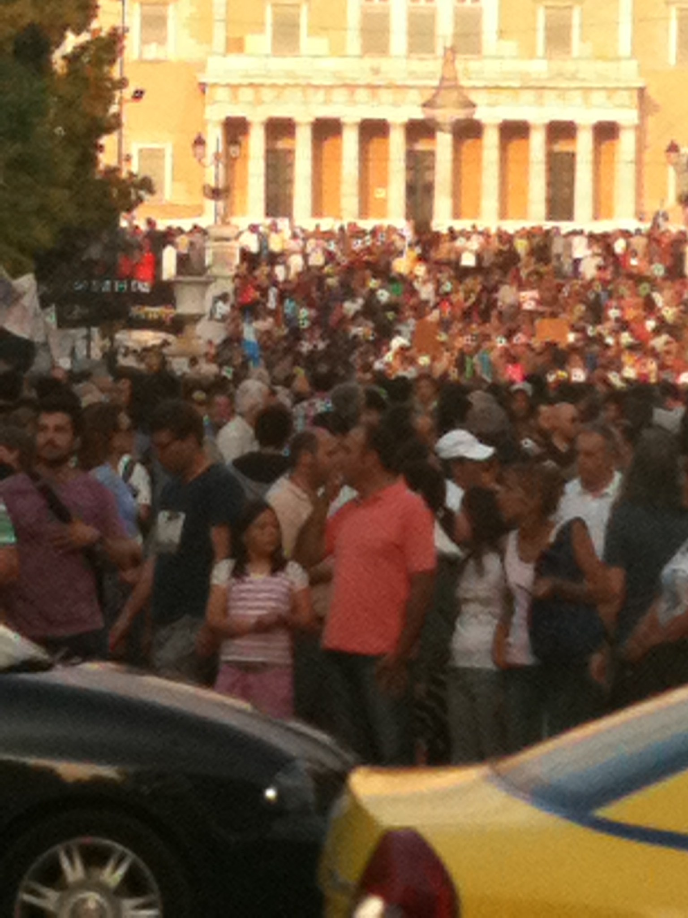
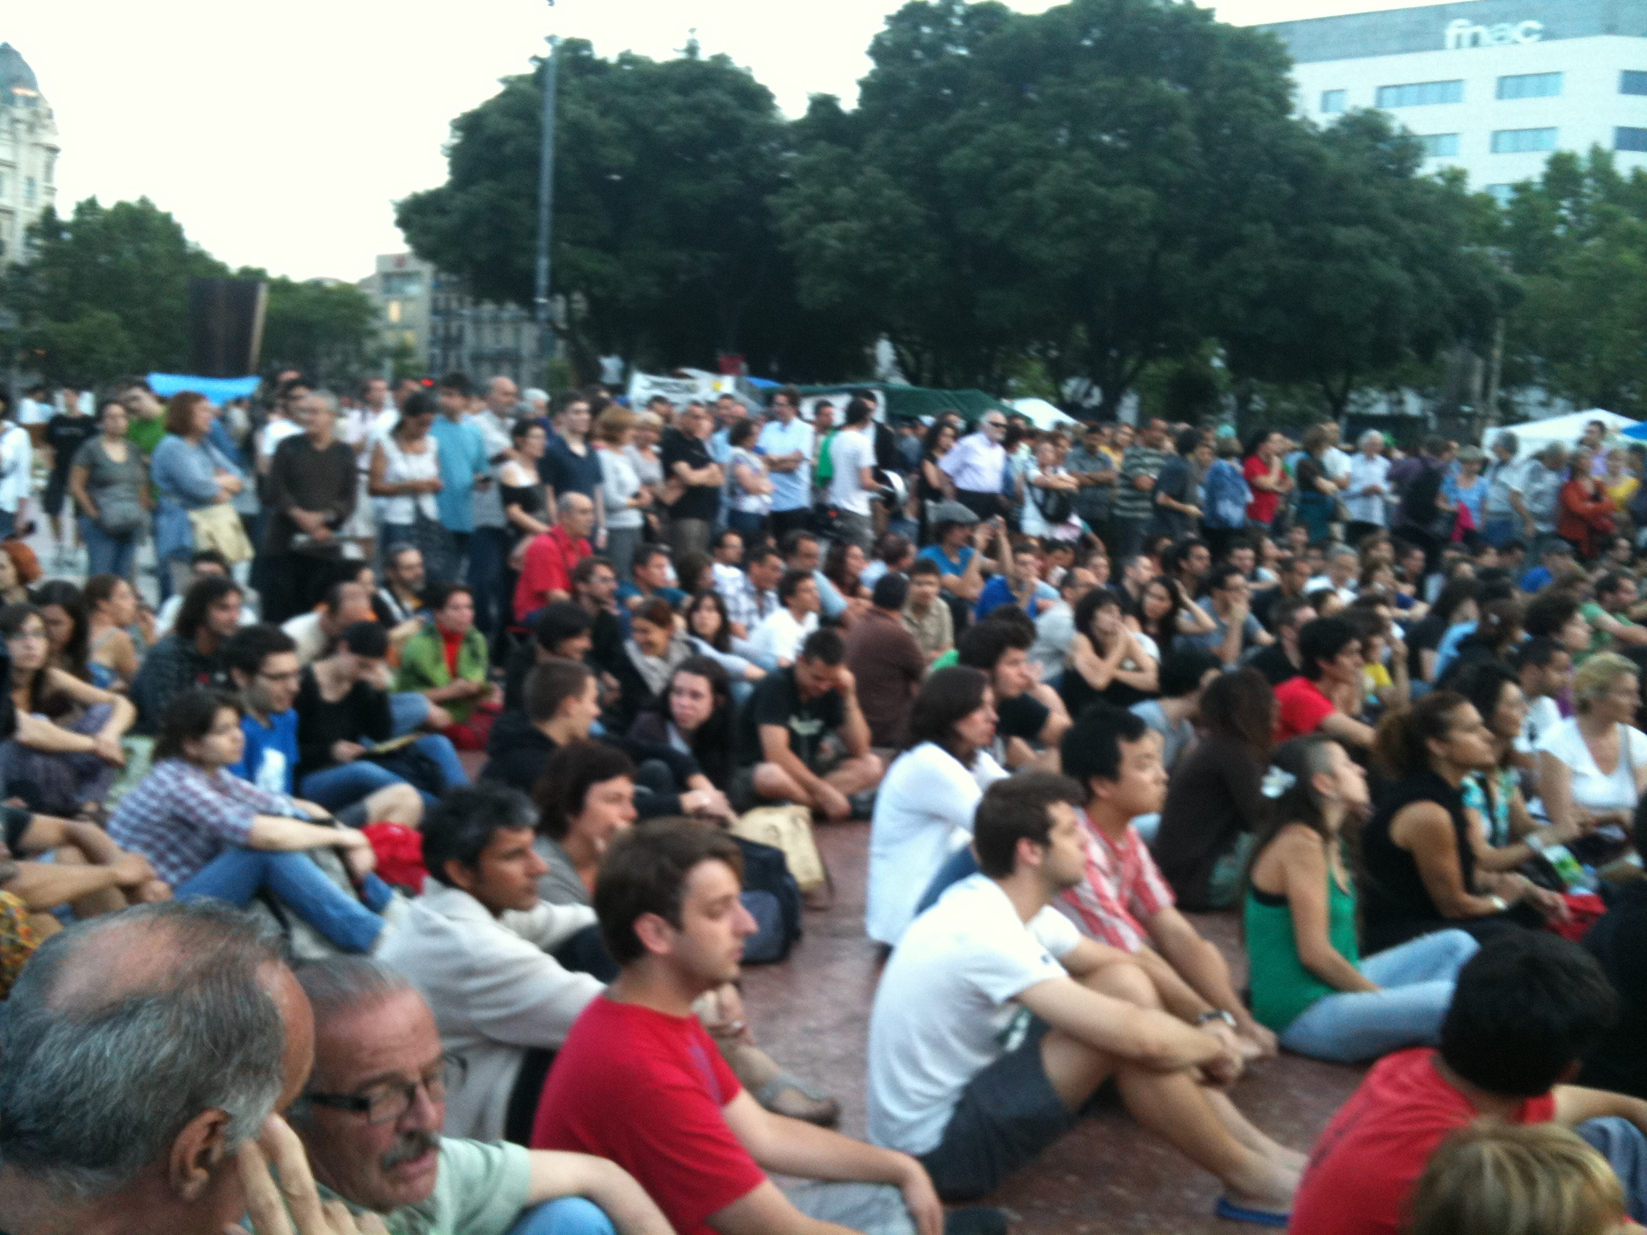

Slide 5
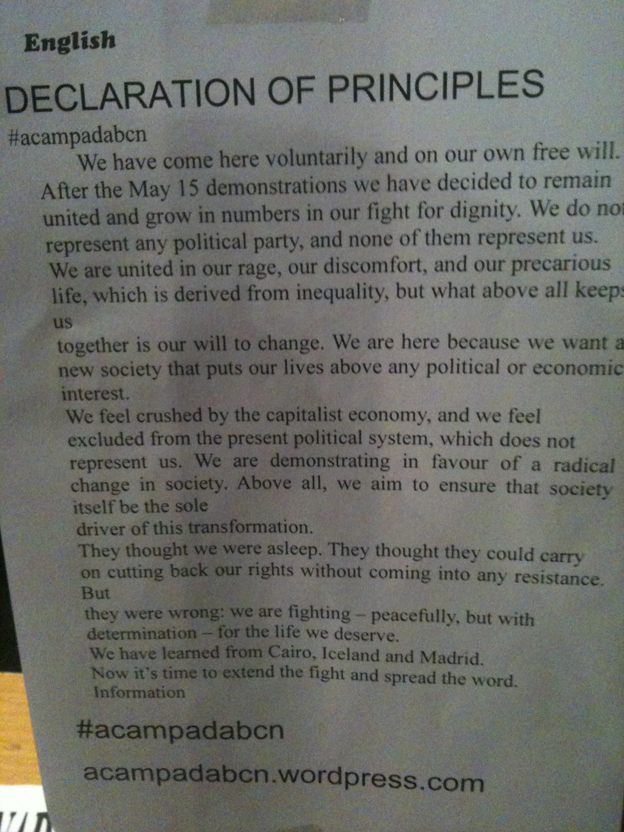
Barcelona 2011

Slide 6
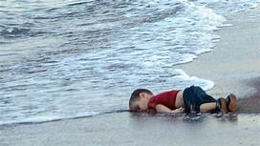

Slide 7
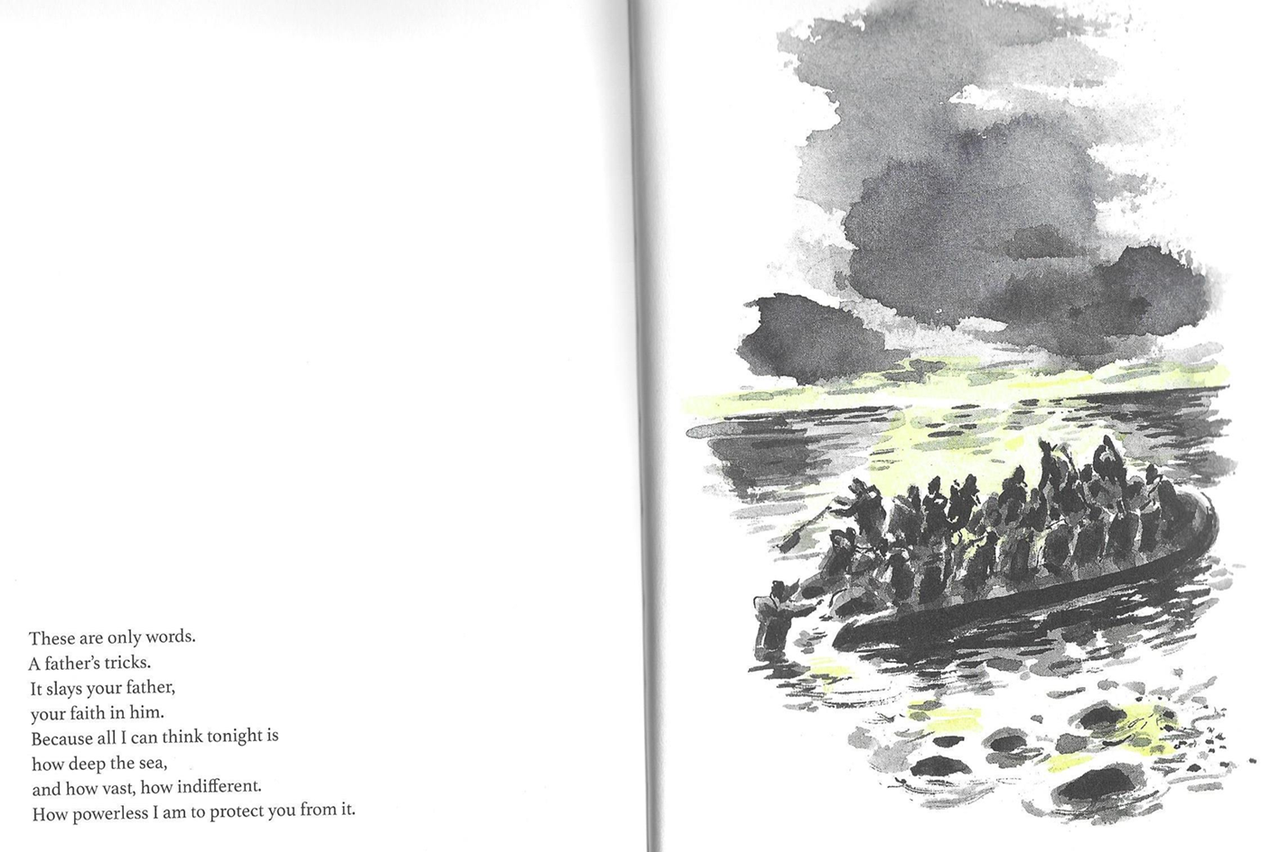

Slide 8
Climate Change
Climate change is a similar contest between those who know about an approaching crisis on the one hand, and those who wish to move on, or at least return to business as usual. In a world where workers unions have been marginalized or have to a large extent lost their ability to engage effectively in triggering such transformative moments we now look to new sources of leverage.

Slide 9
The Plan
The Task Ahead – the ingredients
The Experience of Citizens
The Public Sphere and Democracy
Crisis and Critique
Barriers to Democracy
Transformative Learning
A Critical Education Response
Sociological Imagination
Imagination and the Arts

Slide 10
The Age of Experience – with John Dewey as support
Experience is central to Dewey
Critique of Schooling
Improve the quality of debate and discussion
Our experience is a starting point for learning as it produces
Perplexity – the beginning of ….. Wisdom, curiosity, learning.
The 'demand for the solution of a perplexity is the steadying and guiding factor in the entire process of reflection' (Dewey, 1933, p. 24).
When a 'perplexity lays hold of a mind ... that mind is alert and enquiring because [it is] stimulated from within' (Dewey, 1933, p. 207).
The critical mind always remains uncertain, able to doubt and embraces partial solutions that may or must suffice for now - even if the mind experiences an 'emotional disturbance' (Dewey, 1933, p. 24).

Slide 11
What is adult learning?
The process of re-thinking everything we inherit, defines adult learning, or more accurately adult transformative learning.
Thinking in this way, critical thinking, involves engaging with our experience of the inherited world view, or lifeworld.
The educational task for each individual or learning society is to engage in problematizing (Freire) what we have until that moment taken for granted.
Teachers are facilitators of this process.

Slide 12
Threats to learning
We also know that the fundamentalism of the Far Right ultimately leads to prohibiting public expressions of the experiences of citizens - look at Russia.
To prohibit the expression of experience is an early stage in the move toward the Far Right.
The work of artists and poets is particularly threatening.
To allow the expression of experience is the first step towards, a vibrant public sphere, democracy, and transformative learning.

Slide 13
Dewey (1966) defines education as "that reconstruction or reorganization of experience which adds to the meaning of experience, and which increases ability to direct the course of subsequent experience" (p. 76) and includes "organizing, restructuring and transforming" experience (p. 50).
For Dewey experience has two dimensions:
First, experience is in continuity with previous experience. In pursuing meaning we modify or integrate new experience with previous experiences. For Mezirow (1978) "a meaning perspective refers to the structure of cultural assumptions within which one's new experience is assimilated to - and transformed by - one's past experience" (p. 101).
Second, experience is in interaction with one's broader environment.

Slide 14
Experience and the Public Sphere ‘New’ insight for many (or some) who have not read Hegel….of who have read Freire
Experience is dialectical.
This may have been a missed opportunity for Mezirow (and transformative learning theory) to grasp the full contextualized understanding of experience as outlined by both Hegel, Paulo Freire and Oskar Negt.
A vibrant public sphere is the bedrock of an active democratic society and adult education has a powerful role in developing the 'communities of publics' that engage in the public opinion forming processes (Rasmussen, 2021, p. 15).
We can clearly see the public sphere has changed significantly in the last 50 years. It is digital, commodified and globalized (Habermas, 2022).
Democracy cannot survive in the current digital world without an inclusive public sphere and a deliberative process for the formation of public opinion.

Slide 15
Transformative Learning Transforming Experience
Mezirow (1985) defines transformative learning as; ...
the process of becoming critically aware of how and why the structure of our psychocultural assumptions has come to constrain the way in which we perceive our world, of reconstituting that structure in a way that allows us to be more inclusive and discriminating in our integrating of experience and to act on these new understandings ... (p. 22).

Slide 16
Transformative Conversations
The kinds of discussions and conversations that lead to transformative learning (Mezirow, 1996, p. 115) are open, free, egalitarian, inclusive and participatory and exactly the kinds of discourses that Habermas (1987) describes as communicative action..
In order to be understood, there must be intelligible talk, it must be true, justified, sincere and without the intention to deceive (Mezirow, 1991a, p. 65).
Critical reflection demands a great deal from participants - emotional maturity, empathy, awareness, an ability not to be adversarial in discussions and to think and hold different and contradictory thoughts at the same time.
It does not involve winning or losing but instead emphasizes consensus building - even if that is not always possible (Mezirow, 2000, p. 11).

Slide 17
And where does democracy come into this?
These kinds of discussions are exactly the kinds of conversions that are demanded by a functioning democracy of active citizens. And this is the way I connect transformative learning, democracy, public sphere, critique and crises (Fleming, 2022a).

Slide 18
Oskar Negt – A critical theory of experience
“Experiences of the world unite”
His concept of “exemplary learning “ sets out to analyse the experiences of workers, and by exercising their sociological imaginations, they come to understand these issues and take social action to alter the condition of workers (and learners).
I would like to call the latter recognitive justice - asserting the rights of workers to be recognized.

Slide 19
What does dialectic actually mean in ordinary language?
Imagine a game, owned by for example the
Greek Football Association
Rules are made, followed
Critique
Change, fans follow, and players adjust
Owners and players (and fans) are in a dialectical relationship…..

Slide 20
Towards a Pedagogy of Social Imagination
In praise of wide awakeness
Required: Imagination
Democratic educators care about and for experience
Imagine moving beyond familiar ways of understanding, thinking acting, feeling…
Art invites such imagination

Slide 21
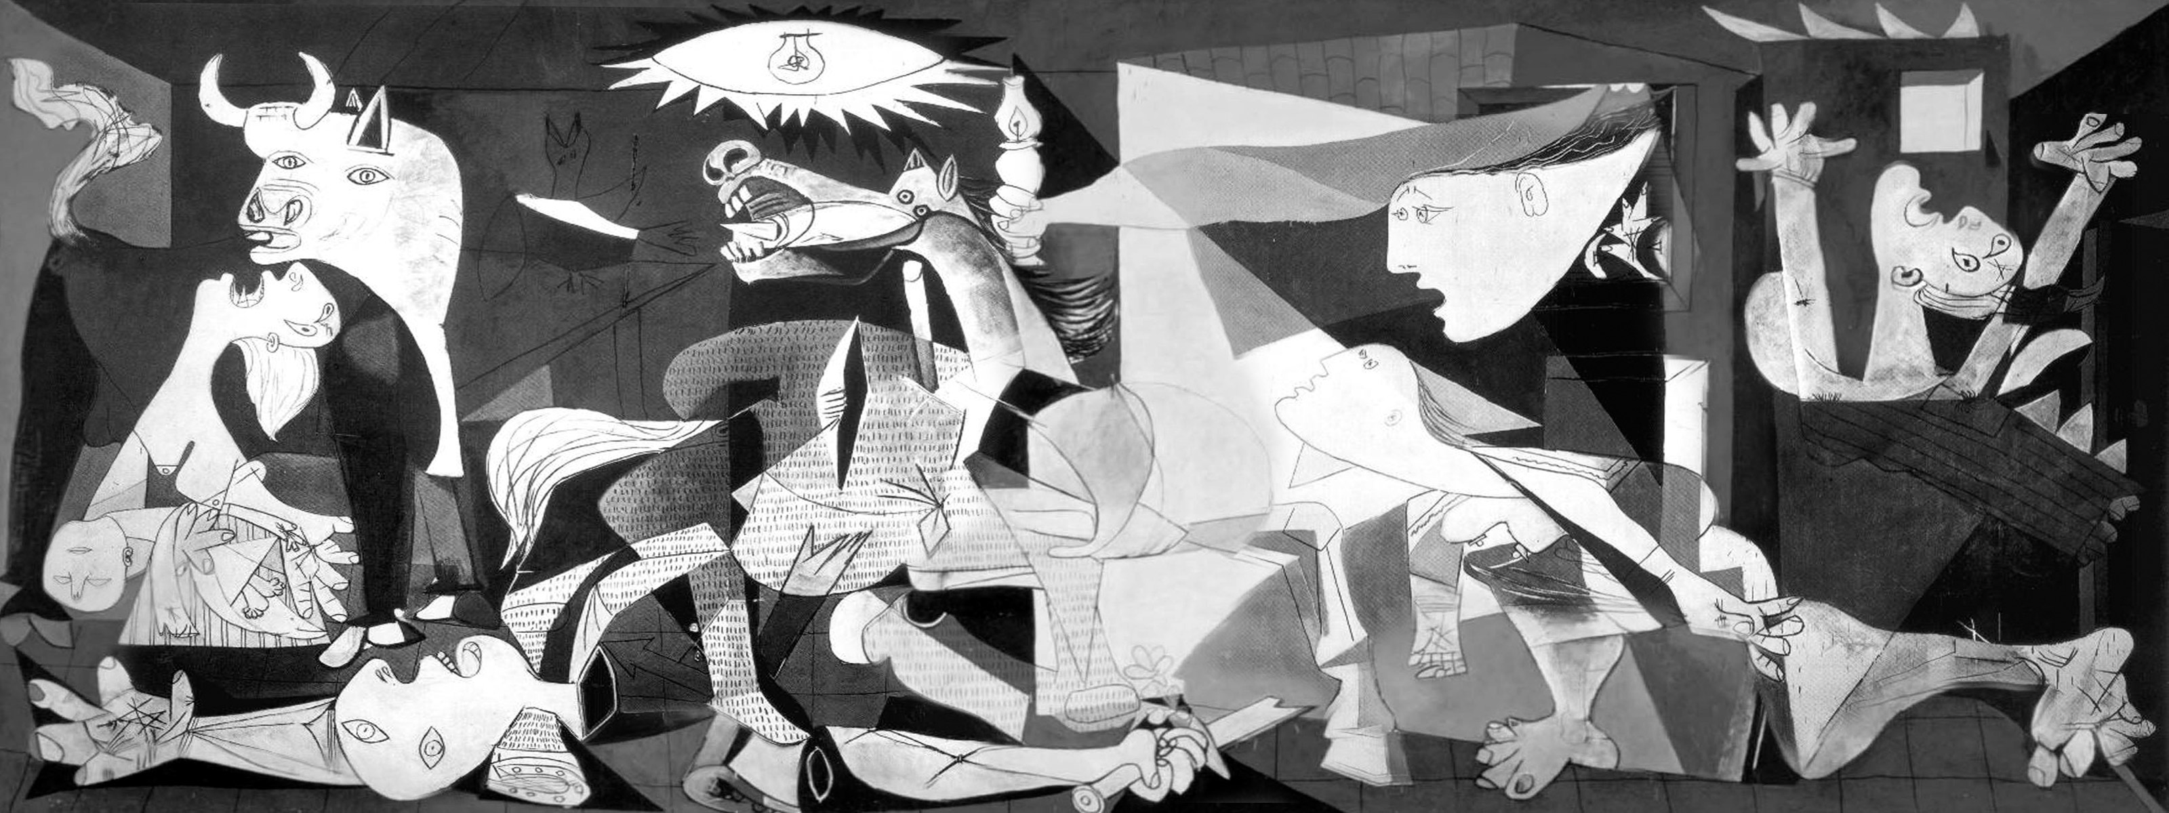

Slide 22
Γκουέρνικα

Slide 23
Towards a Pedagogy of Social Imagination
There is no critical reflection without imagination
Distinguish the dark imagination of Auschwitz

Slide 25
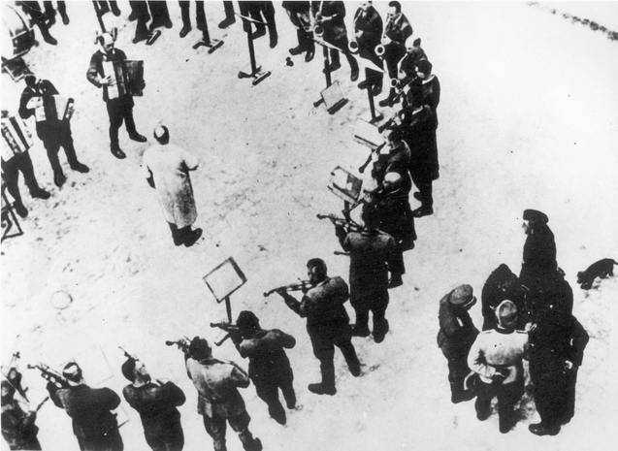

Slide 26
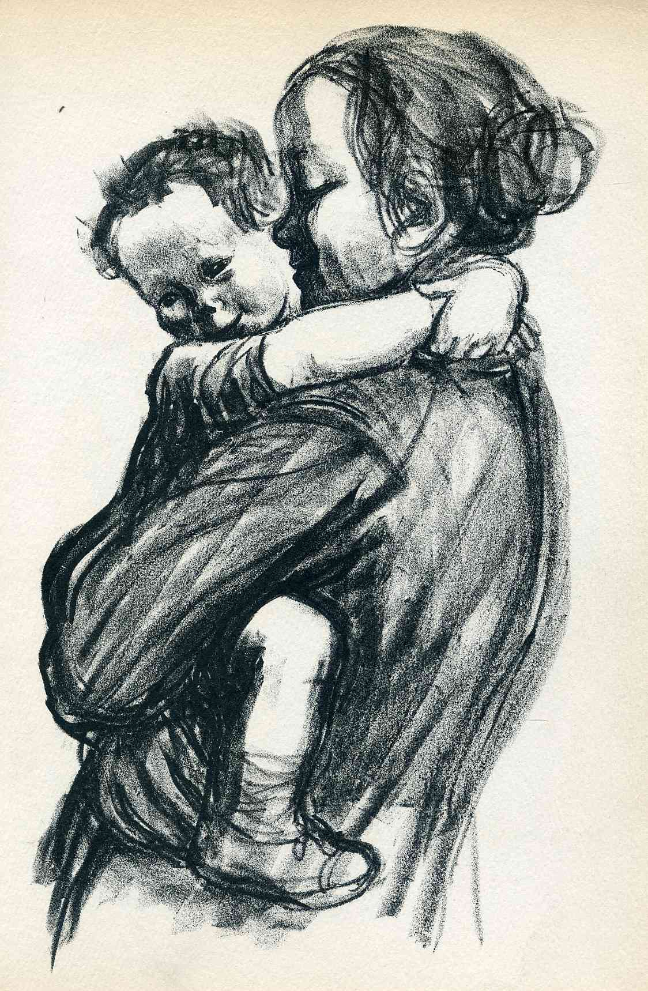

Slide 27
Hannah Arendt
And
Paulo Freire:
Imagination allows people stand on the edge of society and to think beyond the ways that power is exercised now and to at least begin to experience ourselves and “know ourselves as more, much more that pawns in a game where the rules are already set” (Freire, 2004, p. 109).

Slide 28
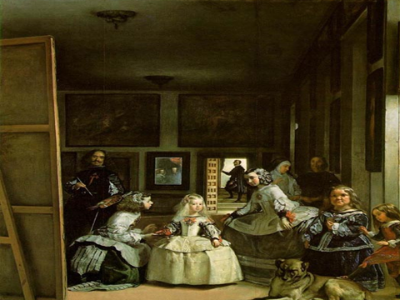
Only with imagination can we see from different points of view
As in this by Valasquez

Slide 29
What images would you use to express living?

